Slide 1
Module III
Area 9 AMIAS Training
Conflict Resolution and
Problem Solving
Conflict
Conflicts with AMIAS Alateens in difficult situations (“Tough Stuff”) Interactions with parents Anonymity
Technology

Slide 2
Dealing with Conflict
Conflict can occur in any group, and dealing with it can make the group and the individuals involved stronger.
See K-70 Using Al-Anon Principles to Resolve Conflict
Take a moment for AMIAS to describe conflicts they may have experienced.
Notes:
References:
2014-2017 Al-Anon & Alateen Groups at Work (P-24), “Group Business Meetings and Group Conscience,” pages 51-53, and “Group Problems and Solutions,” pages 54-55.
Twelve Steps and Twelve Traditions for Alateen (P-18)
Using Al-Anon Principles to Resolve Conflicts Kit (K-70)

Slide 3
Conflict between Alateens and an AMIAS
An open discussion in the group may be helpful. All parties practice the Twelfth Tradition by placing principles above personalities.
The AMIAS the Alateens are having difficulty with may be asked to leave the room as long as there is another AMIAS present.
The group might ask the District Representative (DR), Alateen Coordinator, or another trusted servant to participate in the discussion. An impartial party may provide a new perspective.
The DR or Alateen Coordinator may also help the group take a group inventory.
In order to resolve the conflict, the AMIAS may step down for a time.
Notes:
References:
*Alateen Safety Guidelines (G-34): “Know when to step down,” page 2. “Even if you are totally blameless, stepping aside will not only protect both the Alateen members and you, it will preserve the unity of the fellowship as well.”

Slide 4
Conflict between Alateen Group Sponsors
Some conflicts are personal in nature:
Personality conflicts
Differences in style of recovery
Dominating the group and other AMIASes
Use your resources:
Talk to your DR, Alateen Coordinator,
other trusted servants
Notes:
References:
2014-2017 Al-Anon/Alateen Service Manual (P-24/27), “Group Problems and Solutions,” pages 54-55. See also “Concept Five,” pages 190-193.
Loving Interchange to Resolve Conflict (S-71)
Conflict Resolution Using Our Twelve Traditions (S-72)

Slide 5
AMIAS
in conflict with the Area
Some conflicts are with the Area Alateen Process:
Use of the Alateen name requires compliance with the Area Alateen Safety and Behavioral Requirements.
This is not optional.
The Area Requirements define the qualifications for Alateen Group Sponsor.
Any questions regarding certification can start with the Area Alateen Process Person
The Area Alateen Coordinator, Alateen Process Person, and Delegate work together for Area Process issues.
Notes:
Key points for facilitators:
Know your resources; talk to your DR, Area Alateen Coordinator, other trusted servants.
Communication of concerns and clarification of policies and requirements in a loving way is critical.
References:
2003 Alateen Motion: “Al-Anon members involved in Alateen service and all Alateen members must adhere to the Area’s safety and behavioral requirements, or the Area will notify the WSO that those members are prohibited from participating in Alateen service.”

Slide 6
Alateens and Difficult Situations
Topics teens bring up could be:
Having an incarcerated parent
or sibling
Peer pressure
Abuse or neglect
Sex & sexuality
Suicide
Notes:
References:
A Guide for Sponsors of Alateen Groups (P-29): “Effective Alateen Group Sponsorship Depends Upon:…keeping an open mind when Alateens share” and “knowing the community resources available for other problems when a member asks for extra help, while being cautious not to give advice or specific directions.” (pp. 5-6)
Twelve Steps and Twelve Traditions for Alateen (P-18)

Slide 7
Difficult Situations When you encounter tough stuff
What can an AMIAS do?
Let the child talk about it. Encourage members to find their own solutions.
Suggest a meeting topic to engage the group in general discussion on living with violence or anger.
Know your local laws, especially regarding mandatory reporting. Keep a list of community resources to provide to Alateens if needed.
Talk to other AMIAS, Alateen Coordinator, AAPP and your Service Sponsor. Share your concerns without violating the Alateen’s anonymity.
Notes:
Key points for facilitators:
Suggest a meeting topic on “coping with violence” or “coping with anger.” This will allow the group to deal with the topic without focusing on one individual’s situation.
Know the community resources available for these circumstances—keep a list of these resources. Encourage the Alateens to have a “safe” person to turn to: a relative, counselor, teacher or neighbor. Help them to come up with options for themselves.
When topics such as thoughts of suicide surface, the group can let the member know they are not alone.
Discussion: What to do when a child shares about abuse at home?
Discussion: What have you done when hearing about “tough stuff”? What is the Alateen Group Sponsor’s role?
References:
Alateen Safety Guidelines (G-34): “Alateen Group Sponsors share experience in living with the disease of alcoholism, strength gained from working the Twelve Steps, knowledge of the Twelve Traditions, and hope for the future. An Alateen Group Sponsor is not a counselor, nor the peer of an Alateen member. When an Alateen Group Sponsor gives advice or attempts to solve the problems of the Alateen member, it could lead to unhealthy dependencies.”
A Guide for Sponsors of Alateen Groups (P-29): “…knowing the community resources available for other problems when a member asks for extra help, while being cautious not to give advice or specific directions…”

Slide 8
Difficult Situations Detaching from things you hear in Alateen
Alateens may share family matters that are disturbing. Remember they are only sharing one side of the story. It is important that the Alateen Group Sponsor not place themselves between the child and the parent.
The Alateen Group Sponsors’ or AMIAS’ role is not to “fix” each Alateen’s problems.
Alateen Group Sponsors and AMIAS need to keep their focus on their own recovery, and not let others’ problems become overwhelming.
Notes:
References:
Detachment (S-19)
A Guide for Sponsors of Alateen Groups (P-29): “Effective Alateen Group Sponsorship Depends Upon: …a willingness to listen, being careful not to offer suggestions about their personal lives. Alateens, in sharing with each other, often find their own answers.” (pp. 5-6)

Slide 9
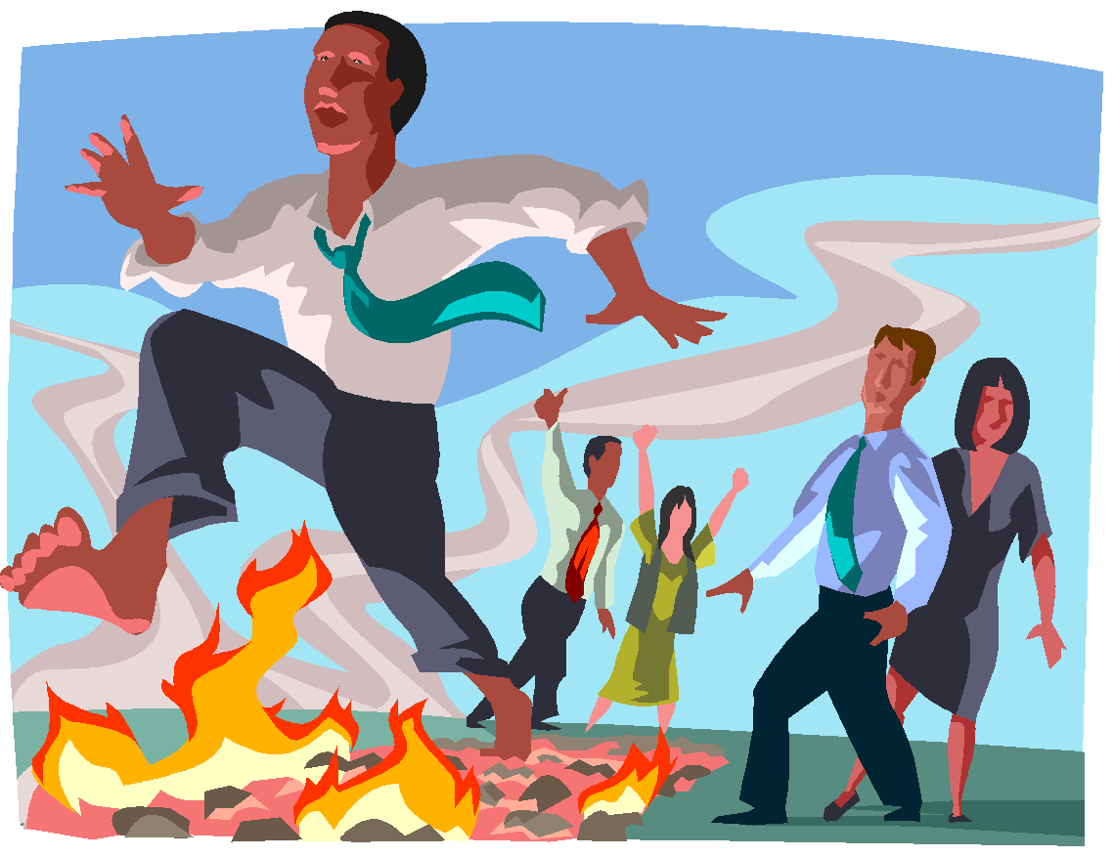
Difficult Situations Avoiding Sponsor burnout
Alateen Group Sponsors need to take steps to avoid burnout, as Alateen sponsorship can be stressful and emotionally draining.
Attend additional Al-Anon meetings.
Reach out to Al-Anon Members and Area trusted servants
Use your personal and service Sponsors.
Put your emotional and spiritual needs first.
Take a break from sponsoring.
Notes:
References:
Detachment (S-19)
A Guide for Sponsors of Alateen Groups (P-29): “Effective Alateen Group Sponsorship Depends Upon:…continued membership and personal recovery in the Al-Anon fellowship.” (pp. 5-6)

Slide 10
Interacting with Parents When parents ask questions
Alateen recovery is about learning to keep the focus on oneself, just as Al-Anon members do.
The Alateen Group Sponsor and the other Alateens are bound by our Tradition of anonymity. In the same way, we respect parents’ confidentiality and do not share what they say with the Alateen member.
Never come between a child and their parent, or undermine the parent’s authority. The Alateen Group Sponsor only has responsibility for the child while the child is in the Alateen meeting or event. The parent’s decisions must be adhered to—whether you agree with them or not.
Notes:
REFERENCES:
How Can I Help My Children (P-9): “Encouraging Alateen,” pages 10-11.
A Guide for Sponsors of Alateen Groups (P-29): “Alateen Group Sponsors Can: stress the importance of anonymity, not only for the parents, but for all members of Al-Anon, Alateen, and A.A. This can be done without instilling a feeling of shame or secrecy.”

Slide 11
Anonymity
It is important to discuss the meaning of anonymity and confidentiality with the Alateen group (Traditions Eleven and Twelve).
Alateens and AMIAS need to understand the importance of “Whom you see here, what you hear here, when you leave here, let it stay here.”
AMIAS protect Alateen confidences when talking with others.
Notes:
References:
Table Anonymity Card (S-9)
2014-2017 Al-Anon/Alateen Service Manual (P-24/27): “Anonymity,” pp. 91-94.
Alateen—Hope for Children of Alcoholics (B-3):
“In Alateen we are all equals. This Tradition teaches us humility. It’s what is said, not who says it, that counts.” (page 45)
“Keep in confidence everything that is said at meetings. If members are assured that what they tell will not be revealed outside the group, they will feel encouraged to speak freely.” (page 100)
*Alateen Safety Guidelines (G-34): “Where reporting is required, there is no choice but to comply with the law…Alateen Group Sponsors and AMIAS who are required by law to report cases of suspected child abuse should let the Alateens know, up front before sharing begins, that they will disclose such incidents that are discussed at the meeting or event…any reporting is done on a personal basis rather than as an Alateen Group Sponsor…” (page 4)

Slide 12
Anonymity Challenges of technology
Anonymity On-line
“Tradition Eleven gives a specific guideline: ‘we need always maintain personal anonymity at the level of press, radio, films, and TV. It is Al-Anon/Alateen policy to interpret Tradition Eleven to include the Internet as well as all forms of evolving public media. Personal anonymity in the media guards the fellowship from the Al-Anon/ Alateen member who may be tempted to seek public recognition.”
2014-2017 Al-Anon/Alateen Service Manual (P-24/27), page 91
Notes:
References:
Alateen—Hope for Children of Alcoholics (B-3): “We maintain our anonymity at the level of press, radio, TV, and film because no one person is authorized to be a spokesperson for Alateen.” (page 44). Al-Anon policy is that Tradition Eleven includes the Internet and other forms of electronic media.
Alateen WSO Facebook page

Slide 13
Anonymity Challenges of technology
“On any Web site accessible to the public, whether an Al-Anon site or not, full names, phone numbers, or other identifying information are not posted, if they are identified as belonging to an Al-Anon/Alateen member.”
Al-Anon/Alateen Service Manual
Alateen identifying information is never posted on the Internet.
Any contacts for an Alateen event posted online should be Area-certified AMIAS.
Discuss other social media with the teens and facilitate a meeting topic on using the Traditions
Notes:
Key points for facilitators:
Information posted on the Internet is available to the general public. For the safety of our Alateens, we never post Alateen phone numbers, e-mail addresses, or any other identifying information.
Example is the “Alateen WSO” Facebook page: this is not a place to share, but a page to use for public outreach, to help to spread the word about Alateen on Facebook.
References:
Guideline for Al-Anon Web Sites (G-40): “Full names should not be used as e-mail addresses in publications or on Web sites. Some areas use an e-mail address system that includes the service position plus the member’s first name and last initial. For safety reasons, never post identifying Alateen information.”

Slide 14
Financial Challenges
It is the goal of every Al-Anon/Alateen group to be “fully self-supporting” (Tradition Seven).
Within Al-Anon/Alateen, members and groups help each other to attain the goal of self support.
Discussion of Tradition Seven in the Alateen group is helpful.
Notes:
References:
2014-2017 Al-Anon/Alateen Service Manual (P-24/27): “It may be difficult for a new Alateen group to meet all its expenses and needs. The local Al-Anon group(s) or district may provide literature or funds to help the group get started, with the goal of the Alateen group becoming fully self-supporting as soon as possible.” (page 90)
Alateen—Hope for Children of Alcoholics (B-3): “Tradition Seven,” pages 37-39
Seventh Tradition (S-21)

Slide 15
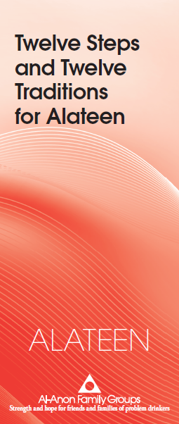
Applying the Traditions in Alateen meetings/events and in Alateen service
Study of the Traditions can:
Help solve problems
Help the Alateens to understand the principles of anonymity and self-support
Alateen CAL Resources:
Alateen—Hope for Children of Alcoholics (B-3)
Twelve Steps and Twelve Traditions for Alateen
(P-18)
Notes:
References:
Alateen—Hope for Children of Alcoholics (B-3): “The Traditions are the result of many lessons learned the hard way. If we pay attention to them, we don’t have to repeat those same mistakes. We will be keeping our group on the right track.”
Courage to Be Me—Living with Alcoholism (B-23)
Conflict Resolution Using our Twelve Traditions (S-72)

Slide 16
questions?
comments?
suggestions?

