Slide 1
Group Representative Orientation
Panel 58

Slide 2
Group Representative* (GR) Basic Housekeeping at Assembly
Registration closes at 10 AM. If you are not registered before that time, you will not be able to vote on any issues brought before assembly.
There are public restrooms located in the hotel lobby.
The chairperson will announce break times.
Please silence all cell phones and electronic devices.

Slide 3
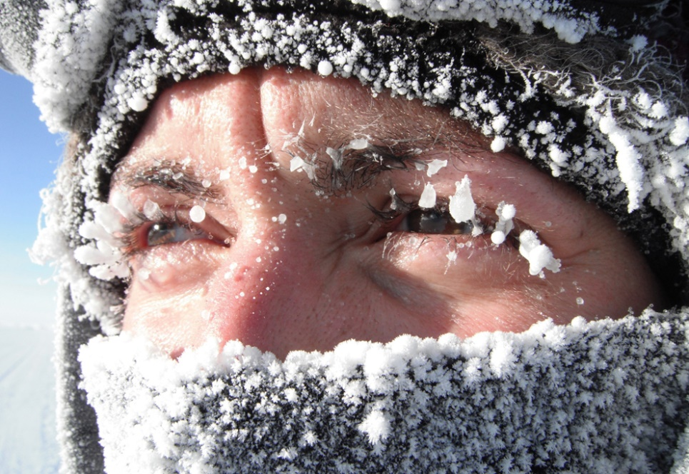
Group Representative* (GR) Basic Housekeeping at Assembly
Please remember this will probably be a long day/weekend. With that in mind, be kind to yourself and others. Please plan for your personal comfort. For example:
If you have medical issues, come prepare with your snacks, medicines and pillows.
If you are always chilly, come prepared with sweaters and/or blanket and comfy socks, so that you will be able to remain comfortable in the meetings and during lengthy discussions.

Slide 4
Group Representative* (GR) Basic Housekeeping at Assembly
Remember as an Al-Anon member you are working for your group, the good of Al-Anon, and area 9.
Concept 3: “The right of decision makes effective leadership possible.” You are not a “group robot.” As you hear new information, you may find that, based on that information, you cannot vote the group conscience. You best represent your group by thinking for yourself and asking for guidance from your Higher Power.

Slide 5
Group Representative* (GR) Excerpts taken from 2014-2017 Service Manual, page 47:
Acts as liaison between the group and the district and between the group and the Assembly.
Familiarizes themselves with the current copy of the Al‑Anon/ Alateen Service Manual (P‑24/27), and encourages its use among group members.
Works through the district in helping to initiate public out‑reach projects.
Encourages Alateen sponsorship in accordance with Area Alateen Safety and Behavioral Requirements.

Slide 6
Group Representative* (GR) Excerpts taken from 2014-2017 Service Manual, page 47:
Serves as local representative of the Al‑Anon/Alateen magazine, The Forum, by:
Acquainting members with its usefulness.
Suggesting personal subscriptions.
Submitting group subscriptions to the WSO.
Encouraging members to write articles.

Slide 7
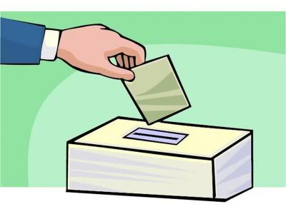
Group Representative* (GR) Excerpts taken from 2014-2017 Service Manual, page 47:
Is elected for a three-year term.
Encourages election of an Alternate GR.
This is a three year commitment and we understand that life happens. Be sure to have a Plan B in place. Having an Alternate GR is an excellent way to cover these bases.
Al‑Anon and Alateen members who are also members of A.A. may not serve as GR or Alternate GR. See “Digest of Al‑Anon and Alateen Policies,” Dual Membership in Al‑Anon/Alateen and A.A.

Slide 8
The GR and World Service Excerpts taken from 2014-2017 Service Manual, page 155-156:
Through the contacts the GR makes with other GRs and the Area World Service Committee, the GR can gain knowledge of Al-Anon world service and the purpose and work of the Conference.
This will enable him to explain these to the group. The GR should be allowed regular time at group meetings to convey information concerning Al-Anon world service affairs.

Slide 9
The GR and the Area Assembly Excerpts taken from 2014-2017 Service Manual, page 155-156:
In addition to attending the election Assembly, the GR is expected to attend all scheduled Assemblies (and any interim Assembly the Chairman or Delegate considers necessary) and to report back to the group. The GR or Alternate GR, in the GR’s absence, votes at the Assembly. Each group has one vote.
GR’s are encouraged to present questions at the microphone during assembly. This can help to clarify any questions. Be mindful that others may ask similar questions. Please be consciences of others’ time. Do not repeat questions that have already been presented. You are allowed two minutes to present a question or comment.
All motions must be filed and seconded by GR’s in writing. Forms are normally kept at the Alternate Delegate’s basket. Be available for all votes.

Slide 10
Service Sponsorship Excerpts taken from 2014-2017 Service Manual, page 49 & 71:
Our Service Manual states that Service Sponsors guide members in applying the Traditions and Concepts of Service, and shares experience, strength, and hope while giving service to Al-Anon.
Service sponsorship helps both the service Sponsor and the sponsee acquire new skills while being an example of personal growth through service.
Al-Anon Family Groups worldwide benefits when members are enthusiastic about service.
For more information about service sponsorship, read the pamphlet Service Sponsorship–Working Smarter, Not Harder (P-88).

Slide 11
Finances Excerpts taken from 2014-2017 Service Manual, page 155-156:
The GR should be mindful of Al-Anon and Alateen’s traditional insistence on being self-supporting.
He makes sure the appeals for support of the WSO, sent four times a year (February, May, August, and November), are read to the group.
He may personally present to his group the appeals sent by the Area Treasurer for support of the Assembly and give the group Treasurer the name and address of the Area Treasurer.

Slide 12
Conference Approved Literature (CAL) Excerpts taken from 2014-2017 Service Manual, page 155-156:
The GR, recognizing the importance of CAL, makes sure that the pamphlet Why Conference Approved Literature? (P-35) is always available at the meeting.
Encourages use of a variety of CAL for meeting topics.

