Slide 1
Alateen Training Module I
Overview of Alateen Service
Area Name
2016
Notes:
Key points for facilitators:
As the title says, this is an overview, and includes: background on the Alateen Motion; definitions of Alateen, Alateen Member Involved in Alateen Service; review of Minimum Requirements; information on our Area Requirements; and local, Area, and WSO Resources.
Note that you may feel free to ask questions on this material and the topics we cover at any time.
Before we get started, let’s find out who’s here today. Please stand (or raise your hand if you prefer) if you are a:
Current Alateen Group Sponsor
Certified AMIAS who is not currently sponsoring a group
Past Alateen Group Sponsor
Area Alateen Coordinator
District or AIS Alateen coordinators/chair
Interested member

Slide 2

Alateen is. . .
…part of Al-Anon Family Groups.
…a fellowship of young people whose lives have been affected by alcoholism in a family member or close friend.
(from the Alateen Suggested Preamble)
Alateen is not…
A program for young people seeking sobriety.
A therapy program.
Notes:
Key points for facilitator:
Ask: What is Alateen? How would you define it?
Alateen is part of Al-Anon Family Groups
Young people come to Alateen seeking recovery from the affects of someone else’s drinking
Ask: What is Alateen not?
Alateen is not for young people coping with their own addictions. This is a common misconception in the outside world.
Alateen is not “therapy," it cannot resolve all problems for young people.
References:
From the 2014-2017 Al-Anon/Alateen Service Manual (P-24/27):
“Al-Anon and Alateen membership is open to anyone who feels his or her life has been affected by someone else’s drinking, either currently or in the past.” (page 40)
“A symptom of alcoholism in the home may be the abuse of drugs by family members. Occasional discussion of this topic is acceptable at an Al-Anon or Alateen meeting as it may be one of the results of living with alcoholism. However, our responsibility is to ensure Al-Anon’s survival as a resource for families and friends of alcoholics. By focusing on these drug-related problems, we risk being diverted from Al-Anon’s primary aim. Referral to appropriate sources of help may be suggested to those in need.” (page 124-25)

Slide 3

Alateen Includes…
Alateen members
Area-certified Al-Anon Members Involved in Alateen Service (AMIAS) to serve as Alateen Group Sponsors
Alateen Group Meetings
Resources to Alateen:
  Supportive Al-Anon groups & members
  Supportive local service arms (district/AIS)
  Area trusted servants
  World Service Office (WSO)
Notes:
Key points for facilitators:
Suggested question: What makes up Alateen? (from the floor)
[click after a few answers to reveal the slide list]
Alateen requires Al-Anon support to exist.
Al-Anon members must go through the Area’s certification process to be directly responsible for Alateens. Once certified, there are a number of ways that Al-Anon members can be of service to Alateen.
Al-Anon members who are not eligible for certification can support Alateen as well, by participating in outreach projects, or helping to plan an event with Alateen participation.
Supportive Al-Anon groups are essential to Alateen—the Al-Anon groups can provide the needed Al-Anon Members Involved in Alateen Service.
If a district or AIS takes responsibility for Alateen, there is an even wider pool of resources.

Slide 4

Alateen Members
Are members of Al-Anon Family Groups who are seeking recovery from the effects of someone else’s drinking.
Share their experience, strength, and hope with each other.
Are generally teenagers; may include
younger family members.
Notes:
Key points for facilitators:
ASK: What can we say about Alateen members? Who are they? Why are they here? What is their role in meetings?
Alateen members are in recovery
Alateen members share peer-to-peer in meetings
Some children younger than 13 may be ready for Alateen. The lower age limit may be set by the group conscience of the Alateen group. It is important that all Alateens be able to participate in a “shared learning experience.”
Resources:
2014-2017 Al-Anon/Alateen Service Manual (P-24/27): “As the name implies, Alateen is designed for members in their teens. Family members below teen years may not be ready for the Alateen program. Such children may have to depend on others to choose what they learn. This could lead to the development of a teaching program. ‘Teaching’ is not compatible with the Al‑Anon principle of sharing. There are, however, younger children who can benefit from the Alateen program, which requires the ability to participate in a shared learning experience.
“It is within the autonomy of each Alateen group to lower the age limit or divide into groups according to age. Whatever the decision, all such groups will be registered as “Alateen” at the World Service Office. Members in their teen years who are legally adults agree to abide by the same requirements as minor Alateens when they attend Alateen meetings and events.” (page 89)

Slide 5
2003 Alateen Motion
Required Areas to set safety and behavioral requirements for all Alateens and all Al-Anon Members Involved in Alateen Service (AMIAS).
These requirements apply to all use of the Al-Anon or Alateen name in conjunction with any meetings, groups, conventions, or any other gatherings in the Area where Alateen participation is offered.
More information on Alateen safety is posted in the “Alateen Service e-Manual” on the WSO Members’ Web site, www.al-anon.org/members.
Notes:
Key points for facilitators:
Since 2003, all Areas in the U.S. and Canada (including Puerto Rico and Bermuda) have implemented Alateen Safety and Behavioral Requirements. The motion came from the World Service Office Board of Trustees, and was affirmed by the World Service Conference in 2004.
It is important to understand that the Alateen Motion is not just about minimum requirements for Al-Anon Members Involved in Alateen Service. All events and meetings using the Alateen name held in the Area must have Safety and Behavioral Requirements to follow that comply with the Area Requirements.
Resources:
Copy of the complete 2003 Alateen Motion and reports of World Service Conference discussion are available in the 2004 and 2005 World Service Conference Summaries, available on the WSO Members’ Web site, al-anon.org/members. See also the Alateen Service e-Manual, also on the Members’ site, for more on Alateen Safety.

Slide 6
Al-Anon Member Involved in Alateen Service (AMIAS)
Is an Al-Anon member who is directly responsible for Alateens while being of service to Alateen.
Each Area clearly defines what roles that involves.
“Instant” or backup Alateen Group Sponsors must have completed certification through the Area Process.
All AMIAS have been certified by their Al-Anon Area.
Notes:
Key points for facilitators:
ASK: What can we say about Al-Anon Members Involved in Alateen Service (AMIAS)? What does “Alateen service” mean?
Every Al-Anon member who takes direct responsibility for Alateen must be certified according to their Area Requirements. Roles may include (customize per your Area Requirements):
- Alateen Group Sponsors
- Temporary/Substitute Sponsors
- Chaperones/Transportation providers
- Al-Anon members showing support for Alateen, who are willing to help as needed
The Board Motion lists minimum requirements; Areas have the option to additional requirements, but all must meet or exceed the minimum.
References:
“An Alateen Group Sponsor is an adult member of Al-Anon who attends Al-Anon meetings regularly, is currently certified as an Al-Anon Member Involved In Alateen Service through their Area’s Alateen process, and has made a commitment to be of service to an Alateen meeting on a regular basis.” [2014-2017 Al-Anon/Alateen Service Manual (P-24/27), page 88]

Slide 7

Alateen Safety and Behavioral Requirements
Minimum Requirements were set by the 2003 Alateen Motion.
Each Area’s Alateen Safety and Behavioral Requirements must meet or exceed the minimums.
Alateen meetings, groups, events, and Al-Anon Members Involved in Alateen Service (AMIAS) must comply with the Area Requirements.
Notes:
Key points for facilitators:
The minimum requirements for use of the name Alateen were set by the 2003 Alateen Motion.
Our Area’s requirements are in compliance with the minimums.
All uses of the name “Alateen” in our Area must be in compliance with the Area Alateen Safety and Behavioral Requirements.
Resources:
Complete Alateen Motion available in the Alateen Service e-Manual, under “Alateen Safety,” on the Members’ Web site, al-anon.org/members.

Slide 8
Minimum Safety and Behavioral Requirements
1. Every Al-Anon member involved with Alateen service must:
  be an Al-Anon member regularly attending Al-Anon meetings.
  be at least 21 years old.
  have at least two years in Al-Anon in addition to any time spent in Alateen.
  not have been convicted of a felony, and not have been charged with child abuse or any other inappropriate sexual behavior, and not have demonstrated emotional problems which could result in harm to Alateen members.
Notes:
KEY POINTS for facilitators:
These are the minimum requirements for certification for service to Alateen that all Areas are required to meet or exceed. [Note any differences from the minimums that your Area has implemented]
This list is directly from the WSO Board of Trustees 2003 Alateen Motion.
Note that references to Al-Anon membership and attending Al-Anon mean membership at the time of certification. For instance, if someone has been away from Al-Anon for a significant amount of time, they should renew their Al-Anon recovery for two years prior to applying for certification. They must also continue attending Al-Anon meetings regularly for as long as they remain in service to Alateen.
This is not a judgment of the quality of anyone’s recovery. We need to know who is with our kids…we need to know that the members with the kids have a solid Al-Anon recovery to share with the kids.
Members who do not meet the Area Requirements for certification can serve Alateen in other ways—by helping with a public outreach project, or helping to plan an event with Alateen participation.
The next slide delineates the remaining minimum requirements.

Slide 9
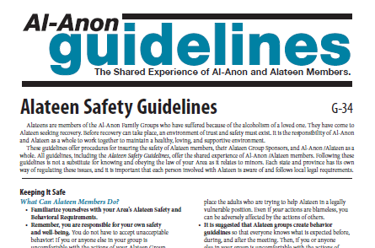
Minimum Safety and Behavioral Requirements (cont’d)
There must be at least one Alateen Group Sponsor at every Alateen meeting.
The Area Requirements:
must prohibit overt or covert sexual interaction between any adult and Alateen member.
must prohibit conduct contrary to applicable laws.
must contain procedures for parental permission and medical care when applicable.
must be reviewed by local counsel.
Notes:
Key points for facilitators:
These are the other minimum requirements incorporated into our Area Policies.
#2: Note that many Areas require at least two Alateen Group Sponsors at every meeting. This is an example showing that the Area has the autonomy to exceed the minimum requirements.
#3: addresses personal interaction between any adult and any Alateen member. Remember that any Alateen member who is legally an adult (age 18 and up) is still an Alateen member.
#4: One common law we have to be aware of is regarding minors and smoking. If your state/provincial law bans minors from smoking, smoking by minors must be prohibited at events using the Alateen name.
#5: Permission form details are included in our Area Requirements.
#6: As laws do vary, your Area Requirements have been reviewed by an attorney familiar with local/state/provincial laws. When changes are made, a local attorney should again be consulted.
References:
Alateen Motion, Available on the Members’ Web site, al-anon.org/members.
From Alateen Conferences guideline (G-16): “Remember — all Alateens, even those who are legal adults, are required to comply with the Alateen Conference guidelines and Area requirements when participating as an Alateen.”

Slide 10
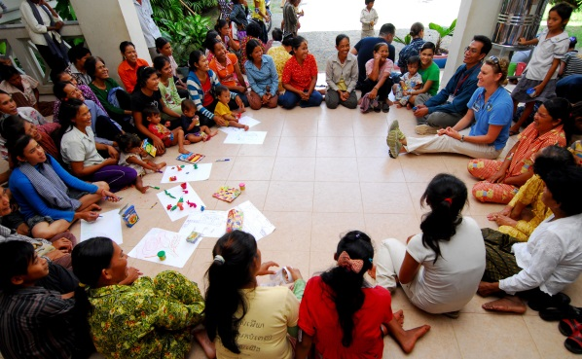
XX Area Alateen Safety & Behavioral Requirements
Insert Area requirements for Al-Anon Members Involved in Alateen Service (AMIAS), including:
        Any requirements in addition to the minimum, such as background checks, minimum age, number of Sponsors, etc.
Notes:
Key points for facilitators:
Review Area Requirements. Add slides as needed.

Slide 11
XX Area Alateen Safety & Behavioral Requirements
Insert other requirements for groups, meetings, events. Use as many slides as needed.
Notes:
Key points for facilitators:
As you can see, there are several slides included for customization—Areas can add as many as they want.

Slide 12

Trusted Servants in the
Area Alateen Process
[Customize according to your Area Process]
Area Alateen Coordinator
Area Alateen Process Person (AAPP)
District Representative/Alateen Chair
Notes:
Key points for facilitators:
Two key players in your Area Alateen Process are the Area Alateen Coordinator and the Area Alateen Process Person or AAPP. (In some Areas, one person may fill both roles.)
Your District Representative and/or District Alateen chair may play a role in the process.
An Area may define their responsibilities differently, but for WSO purposes, the AAPP is the contact person between WSO Group Records and the Area. The Alateen Coordinator is the channel of communication on all other matters pertaining to Alateen
Be sure to include the relationship between your Area Alateen Coordinator and Area Alateen Process Person (AAPP), and how they and your other Area and district trusted servants will work together to put all the pieces together.
RESOURCES:
Area Alateen Safety and Behavioral Requirements
Area Alateen Coordinators guideline (G-24)

Slide 13
Al-Anon Members Involved in Alateen Service (AMIAS)
XX Area Certification Process
[insert steps of Area Process—add slides as needed]
Include:
    Forms to use
    Where to send them
    Instructions for background checks, if required
    Training schedules
Notes:
Key points for facilitators:
Again more slides for customization…The Area can get as specific as desired about the Area process.

Slide 14
Starting an Alateen Group
Follow the Area Process for certification of Alateen Group Sponsors and meeting registration.
  Work with Area/district/AIS Alateen Coordinator(s) and the AAPP.
Set meeting place/time.
Al-Anon group support is helpful.
Alateen meetings are closed, attended by Alateens and the Area-certified Alateen Group Sponsors only.
Notes:
Key points for facilitators:
People looking to start a group will be referred to the Area Alateen Coordinator, who can provide information about certification requirements, and/or work to find AMIAS who may be able to help a group get started.
The first step for an Al-Anon member who wants to start an Alateen meeting is to become certified as an Al-Anon Member Involved in Alateen Service (AMIAS).
Locate a meeting place—starting a meeting at the same time and place as an Al-Anon group is highly recommended.
All the paperwork to become certified and to register an Alateen group must go through the Area process. Once certification and registration are complete, the group meetings can begin.
Members interested in Alateen service go through the certification process in order to be in the Area’s pool of potential Alateen Group Sponsors, and follow Area direction on training and visiting groups after they are certified.
Suggested question: How can an Al-Anon group support Alateen?
Access to certified backup Alateen Group Sponsors
Encourages members to bring their children
Access to a meeting if certified Group Sponsors are absent
While the paperwork is in process, work on generating interest in Alateen in local A.A. and Al-Anon groups, and in the community.
Resources:
WSO Members’ Web site, www.al-anon.org/members.
Alateen Service e-Manual
Starting an Alateen Group Guideline (G-19)
Alateen Safety Guidelines (G-34)

Slide 15

The New Alateen Meeting
The first meeting will be exciting for all concerned.
Ask the group to set its own behavioral guidelines. Remind them they are responsible for their group.
Remember it’s the Alateens’ meeting!
Notes:
Key points for facilitators:
A brand new meeting is an exciting time—it is an opportunity to set the tone with the Alateens, inviting them to create their own behavioral guidelines, and that they will be responsible to monitor the group themselves.
Remember that Alateen members may need help in forming a group and running their meetings. However, they are capable of conducting their own meetings and handling group responsibilities. We encourage them to do so.
We remember not to monopolize the meeting. When it’s our turn, we briefly share our experience with the Twelve Steps and knowledge of the Twelve Traditions. We encourage Alateens to share.
Have fun!
Suggested discussion topic: What are some safety requirements that an Alateen Group Sponsor might set? What behavioral guidelines might the Alateens consider?

Slide 16
Alateen Group Sponsors
Are necessary to have an Alateen meeting.
Provide support and encouragement to the Alateen group as a whole.
Encourage and help the teens to run their own meetings.
Avoid one-on-one interactions.
Notes:
Key points for facilitators:
In this overview, we want to clarify the basic roles of an Alateen Group Sponsor.
Suggested question: what do you see as the key responsibilities of Alateen Group Sponsors? [generate ideas, then click to see list on slide]
More detail is available in the Alateen Service e-Manual on the Members’ Web site. [If your Area offers Module II on The Alateen Group Meeting, let them know!]
References:
“Alateen Group Sponsors: An Alateen Group Sponsor is an adult member of Al-Anon who attends Al-Anon meetings regularly, is currently certified as an Al-Anon Member Involved In Alateen Service through their Area’s Alateen process, and has made a commitment to be of service to an Alateen meeting on a regular basis.” (2014-2017 Al-Anon/Alateen Service Manual, page 88)

Slide 17

We always…
Keep the
_____
on Al-Anon/Alateen
___________.
focus
principles
Notes:
Key points for facilitators:
Al-Anon/Alateen is spoken here: Keep it Al-Anon/Alateen (focus on Steps, Traditions, Concepts).
[Ask to fill in the blanks…click mouse for hint…]
Suggested Discussion topic: What does “keep the focus on…” mean? How do we do that?

Slide 18
Alateen Personal Sponsors
Alateens are encouraged to ask another Alateen member to be their personal Sponsor, with whom they can discuss personal problems and program questions.
Just as in Al-Anon, Alateen personal Sponsorship is a peer-to-peer relationship.
Notes:
Key points for facilitators:
Alateen Group Sponsors do not serve as personal sponsors to individual Alateens. A personal Sponsor relationship is “peer-to-peer.”
Alateen members should be encouraged to ask another Alateen member to be their personal Sponsor as their peer.
Suggesting the meeting topic of “Sponsorship” can help the Alateens to understand this better.
Suggested discussion topic: How can Alateen Group Sponsors encourage and help Alateens to sponsor each other?
References:
“Alateen Personal Sponsors: Alateen Group Sponsors and other Al-Anon members do not serve as personal Sponsors to individual Alateens. Alateen members are encouraged to sponsor each other in a peer-to-peer relationship.” (2014-2017 Al-Anon/Alateen Service Manual, page 89)
Courage To Be Me (B-23), “Sponsorship,” pages 269-279

Slide 19
Alateen Resources
  In the District
  Alateen Group Sponsor Workshops
  District/AIS Trusted servants (add contact info if desired)
  District Representative
  District/AIS Alateen Chair/Committee
  Other Alateen Group Sponsors/AMIAS
Notes:
Key points for facilitators:
As with all Al-Anon recovery and service: you are not alone! There is a network of support for our Al-Anon Members Involved in Alateen Service (AMIAS), and we encourage you to use them.
ASK: WHAT ARE SOME OF OUR ALATEEN RESOURCES?
Talk to each other: we encourage all Al-Anon Members Involved in Alateen Service to reason things out together. Your district trusted servants are available to you.

Slide 20
Alateen Resources
In the Area
Area Alateen Workshops
Area Trusted Servants [insert name/contact info]
  Alateen Coordinator
  Area Alateen Process Person (AAPP)
Area Alateen Requirements
Area Alateen Process
[add resources as appropriate, including additional slides if needed]
Notes:
Key points for facilitators:
It’s very important that anyone involved with Alateen know how to reach their resources. Here are some Area resources. (customize)

Slide 21
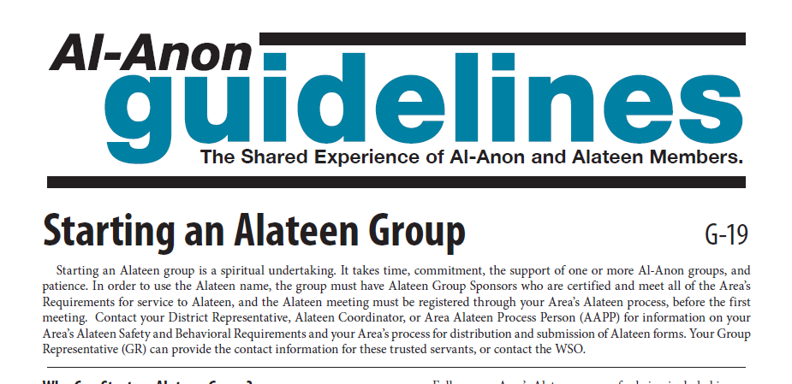
Alateen Resources
World Service Office
Alateen Service e-Manual on the Members’ Web site, al-anon.org/members, including guidelines:
  Alateen Safety Guidelines (G-34)
  Starting an Alateen Group (G-19)
  Alateen Meetings in Schools (G-5)
  Alateen Conferences (G-16)
  Area Alateen Coordinators (G-24)
Notes:
Key points for facilitators:
The World Service Office provides guidelines and service tools.
Visit the Alateen Service e-Manual on the Members’ Web site, al-anon.org/members. All Alateen guidelines are included here.
WSO staff is available as a resource.

Slide 22
Responsibility Statement
“AMIAS are to provide direction to assure that emphasis is placed on the Al-Anon/ Alateen program of recovery and, to the best of their ability, maintain an atmosphere that will protect the Alateen members from physical and emotional harm.”
The Responsibility Statement can be found on the WSO Alateen Safety Guideline, G-34, available on the Members’ Web site, al-anon.org/members.
Notes:
Key points for facilitator:
The Responsibility Statement can be found in the WSO Alateen Safety Guidelines, G-34, available on the Members’ Web site, al- anon.org/members.
The complete Responsibility Statement clarifies the roles and responsibilities of Al-Anon Members Involved in Alateen Service, including:
Requirements for service to Alateen
Roles
Suggestions
Legal and Traditional responsibility

Slide 23
Safety Checklist
Al-Anon Members Involved in Alateen Service:
Work their own Al-Anon program.
Use their personal and service Sponsors.
Participate in local/Area Al-Anon/Alateen events.
Avoid one-on-one interactions with Alateens.
Know when to step down as an Alateen Group Sponsor.
Attend district and Area service meetings whenever possible.
Participate in Alateen Sponsor Workshops.
Stay informed—connect with the Area Alateen Coordinator.
Use all their resources!
Talk to each other, reason things out with someone else…
Notes:
Key points for facilitators:
We welcome you to Alateen service—it is a rewarding job. We want to close this session with a few reminders, things that can help avoid “Sponsor burnout”
Suggested question: Before we give you our list, who would like to name some safety tips? [Some ideas follow]
Maintain and work your Al-Anon recovery program.
Keep safety in mind at all times.
Use your Alateen resources.
Seek and obtain support in any way you need it.
Take a break when you need to.
The more people who are certified, the easier it will be to keep Alateen going and thriving. Alateen groups are dependent on having Alateen Group Sponsors. If our Alateen Group Sponsors know they will have assistance when needed, they will be more likely to stay “on the job.”

Slide 24
Wrap Up
Welcome to the world of Alateen service
Contacts for questions:
  Local Contact, phone, e-mail
  XX Area Alateen Coordinator
  Insert name, phone number, e-mail
  XX Area Alateen Process Person (AAPP)
  Insert name, phone number, e-mail
Notes:
Key points for facilitators:
This concludes this Alateen Training Module – an Overview of Alateen Service.
Other module topics are:
The Alateen Meeting
Alateen Events
Alateen Challenges
The next training will be: [insert info]

