Slide 1
We’re Here!! We’re Here!!
Notes:
From: al-anon.org website – Virtual Meetings
Al-Anon electronic meetings use different online platforms: discussion boards, email, chat, phone and Voice over Internet Protocol (VoIP), such as Skype. Each meeting is autonomous in its style, format, and entry procedures and, like all Al-Anon meetings, agrees to abide by the spirit of the Twelve Traditions. Meetings focus on Al-Anon-related topics, and participants are required to maintain their personal anonymity.
Pictures of Al-Anon members and other pieces of personally identifying information are not posted in the meetings. Some participants may have email addresses specifically for the online Al-Anon meeting use and some use pseudonyms.
Each meeting may have its own entry procedures. Some online meetings have an email contact where a “greeter” will provide the newcomer with specific directions to access the meeting.
Meetings that don’t list a specific meeting time are held 24/7.
<CLICK>

Slide 2
What are they?
Where are they?
Who are they?
Notes:
2018-2021 Al-Anon/Alateen Service Manual (P-24/27), p. 27
In 2001, the WSO started registering online meetings, and in 2007, phone and other electronic meetings. Electronic meetings offered Al-Anon members a means of connecting and sharing the Al-Anon program regardless of location.
By 2018 there were over 25,000 groups in 133 countries and 107 electronic (digital, social media and phone) meetings.
To find electronic/virtual (EVM) meetings—go to the Al-Anon website, under the “Find a Meeting” tab/Virtual Meetings—the registered electronic meetings include the following:
Bulletin Board/Secured Blog
Email Meetings
Voice Over Internet Protocol (VoIP) (Skype)
Phone Meetings
<CLICK>

Slide 3
WSO is asking “How Can Our Electronic/Virtual Meetings Be Included in Our Structure?”
Notes:
2018-2021 Al-Anon/Alateen Service Manual, pp. 88-89 — Electronic Meetings
The internet and other electronic telecommunications media are tools for carrying and sharing the Al-Anon program of hope and recovery around the world. These electronic meetings occur globally as well as locally without geographic restrictions. Consequently, electronic meetings do not have a Group Representative and are not a part of any structure. They do, however, have a meeting contact.
When electronic meetings form, they register with the World Service Office (WSO) in order to use the Al-Anon name. Upon registration, they receive support from and have their voices heard and represented through the WSO. Registered meetings may request a license from the WSO to use in text format the Steps, Traditions, Concepts of Service, Suggested Welcome, Suggested Closing and excerpts from Conference Approved Literature (CAL).
The WSO staff and the Board of Trustees are discussing ways these meetings could be included in our structure. How can we be of service?
In a culture of Knowledge Based Decision Making – how can we work with this if we do not have experience with it?
How can we gain experience?
<CLICK>

Slide 4
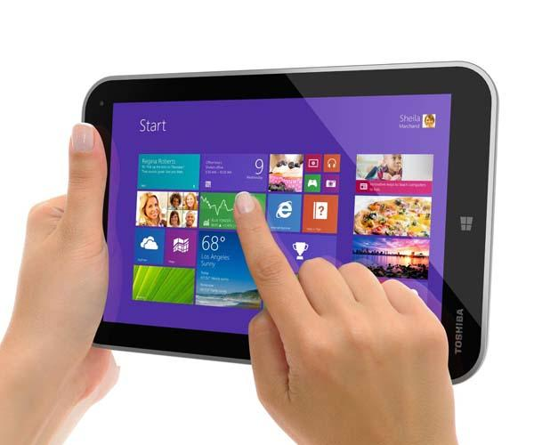
Our Current Structure
Group
District
WSO Registration
Area
Meeting
Meeting
Member
Group
District
Area
WSC
Virtual Member
Notes:
Today‘s discussion is just a beginning. The electronic/virtual meetings have been registered and holding meetings since 2001.
Our discussion today will include some things we know about the meetings and some we wish we knew.
Looking at this slide you can see:
Face-to-face meetings have a service structure path of member-to-group-to-District-to-Area; and via the Delegate to WSC
Electronic/virtual meetings have a service structure of member-to-meeting-to-WSO; and via WSO Staff to WSC
Do the electronic/virtual meetings consider this adequate? We don’t know?
Face-to-face meetings have fixed geographic boundaries.
Members of electronic/virtual meetings have no geographic boundaries. They can be anywhere in the world. Email may be the only means of contact.
<CLICK>

Slide 5
DISCUSSION
How do I feel about this?
What do I think about this?
Why would I want to attend one?
Are these meetings going to replace face to face meetings?
What do we know?
What do we wish we knew?
Notes:
Some things to consider in our discussion:
How are they like a face-to-face meeting?
How are they different?
There are active members and “lurkers” (members who join and observe, but do not participate in the discussion) — Is this the same as members attending face-to-face meetings who choose to listen, but not share?
Different: After the meeting is registered, the form for reprint permission is sent to the Current Mailing Address (CMA) of the meeting. Reprint permission forms must be submitted annually. This may be difficult for an electronic, phone or social media meeting to comply with.
Same: The meeting cannot happen when the person with the “key” for the meeting room doesn’t show up. For the electronic/virtual meeting, when the person with the login doesn’t show up, the meeting cannot happen.
We will now open the floor for discussion.
<END>

